Slide 1
Lung Cancer Survival Prediction Using Machine Learning
An Innovative Approach to Enhancing Patient SURVIVAL Outcomes
Presented by:
AKASH VISHWAKARMA (240843025005)
SWAPNIL PANDA (240843025044)
ARBAJ RIYAJ SHAIKH (240843025008)
JAYDEEP DHANAJIRAO SHINDE (240843025017)

Slide 2
INTRODUCTION
Lung cancer is a leading cause of cancer-related deaths worldwide, with over 2.2 million new cases annually. Accurate survival prediction is essential for optimizing treatment strategies, enhancing patient communication, and improving clinical outcomes.. Recent advancements in machine learning (ML) provide powerful tools for analyzing complex datasets, enabling improved prognostic accuracy.

Slide 3
Problem Definition
We aim to predict the survival outcome of patients having lung cancer using different attributes such as age, gender, cancer stage, treatment type, family history and lifestyle factors, which may influence survival rates. This will lead to better-informed treatment decisions and personalized patient care. It also facilitates the identification of high-risk patients, ultimately improving survival rates and quality of life

Slide 4
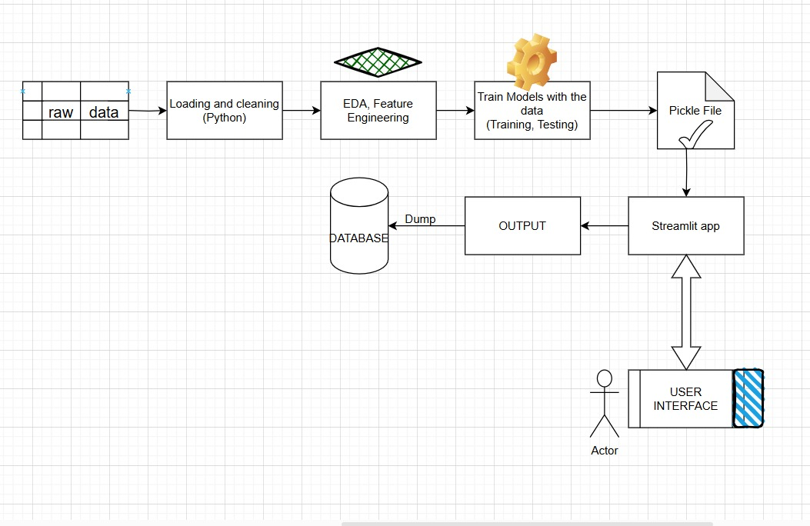
Workflow

Slide 5

Streamlit
Streamlit is an open-source Python framework designed for building interactive and data-driven web applications. It is particularly popular among data scientists, machine learning (ML) practitioners, and analysts due to its simplicity and ability to create fully functional web applications.

Slide 6
Database Integration
It means Storing and retrieving user inputs or predictions from a database.
Steps:
1. Choosing a Database
2. Installing Dependencies (To integrate a database, install relevant Python libraries)
SQLAlchemy – For database connection and ORM support.
3. Establishing a Database Connection
4. Capture user inputs and inserts them into the database securely.

Slide 7
Exploratory Data Analysis(EDA) & Feature Engineering
EDA
Survival Distribution
Age distribution by Survival Status
Gender Distribution by Survival Status
smoking status Distribution by Survival Status
Cancer Stage Distribution by Survival Status
Treatment Type Distribution by Survival Status
Family history Distribution by Survival Status
BMI and Cholesterol levels distribution by Survival Status
Hypertension , BMI, Asthma, cirrhosis, other_cancer distribution
Feature Engineering
Ordinal encoding and one hot encoding of categorical features
Feature Scaling
Calculate treatment delay
Calculate duration of treatment in days

Slide 8
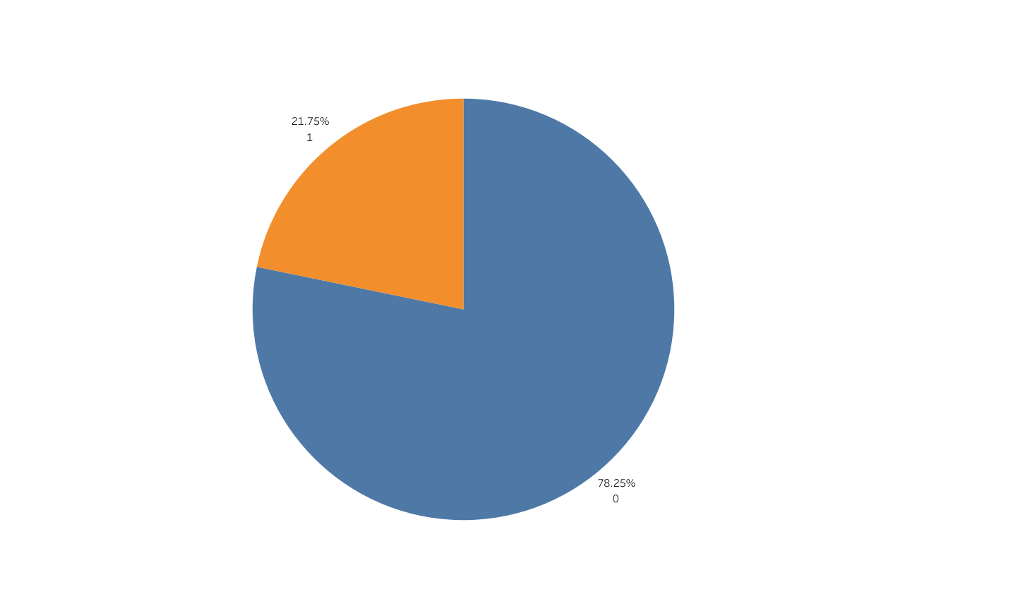
EDA – Survival Distribution

Slide 9
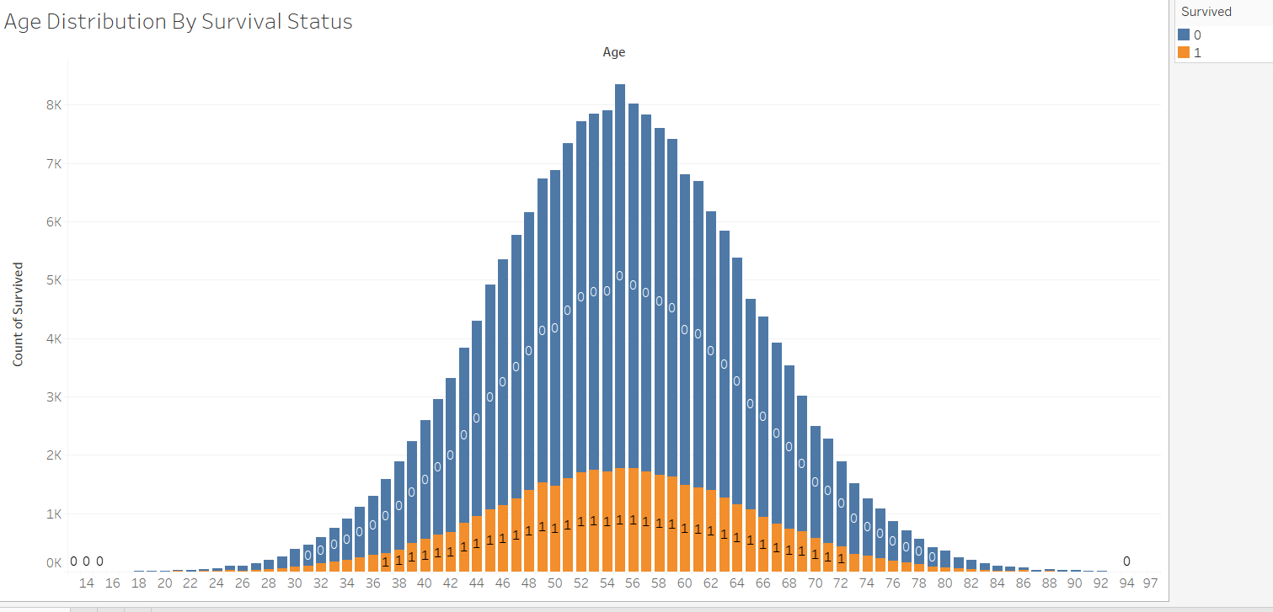
EDA-Survival By Age Distribution

Slide 10
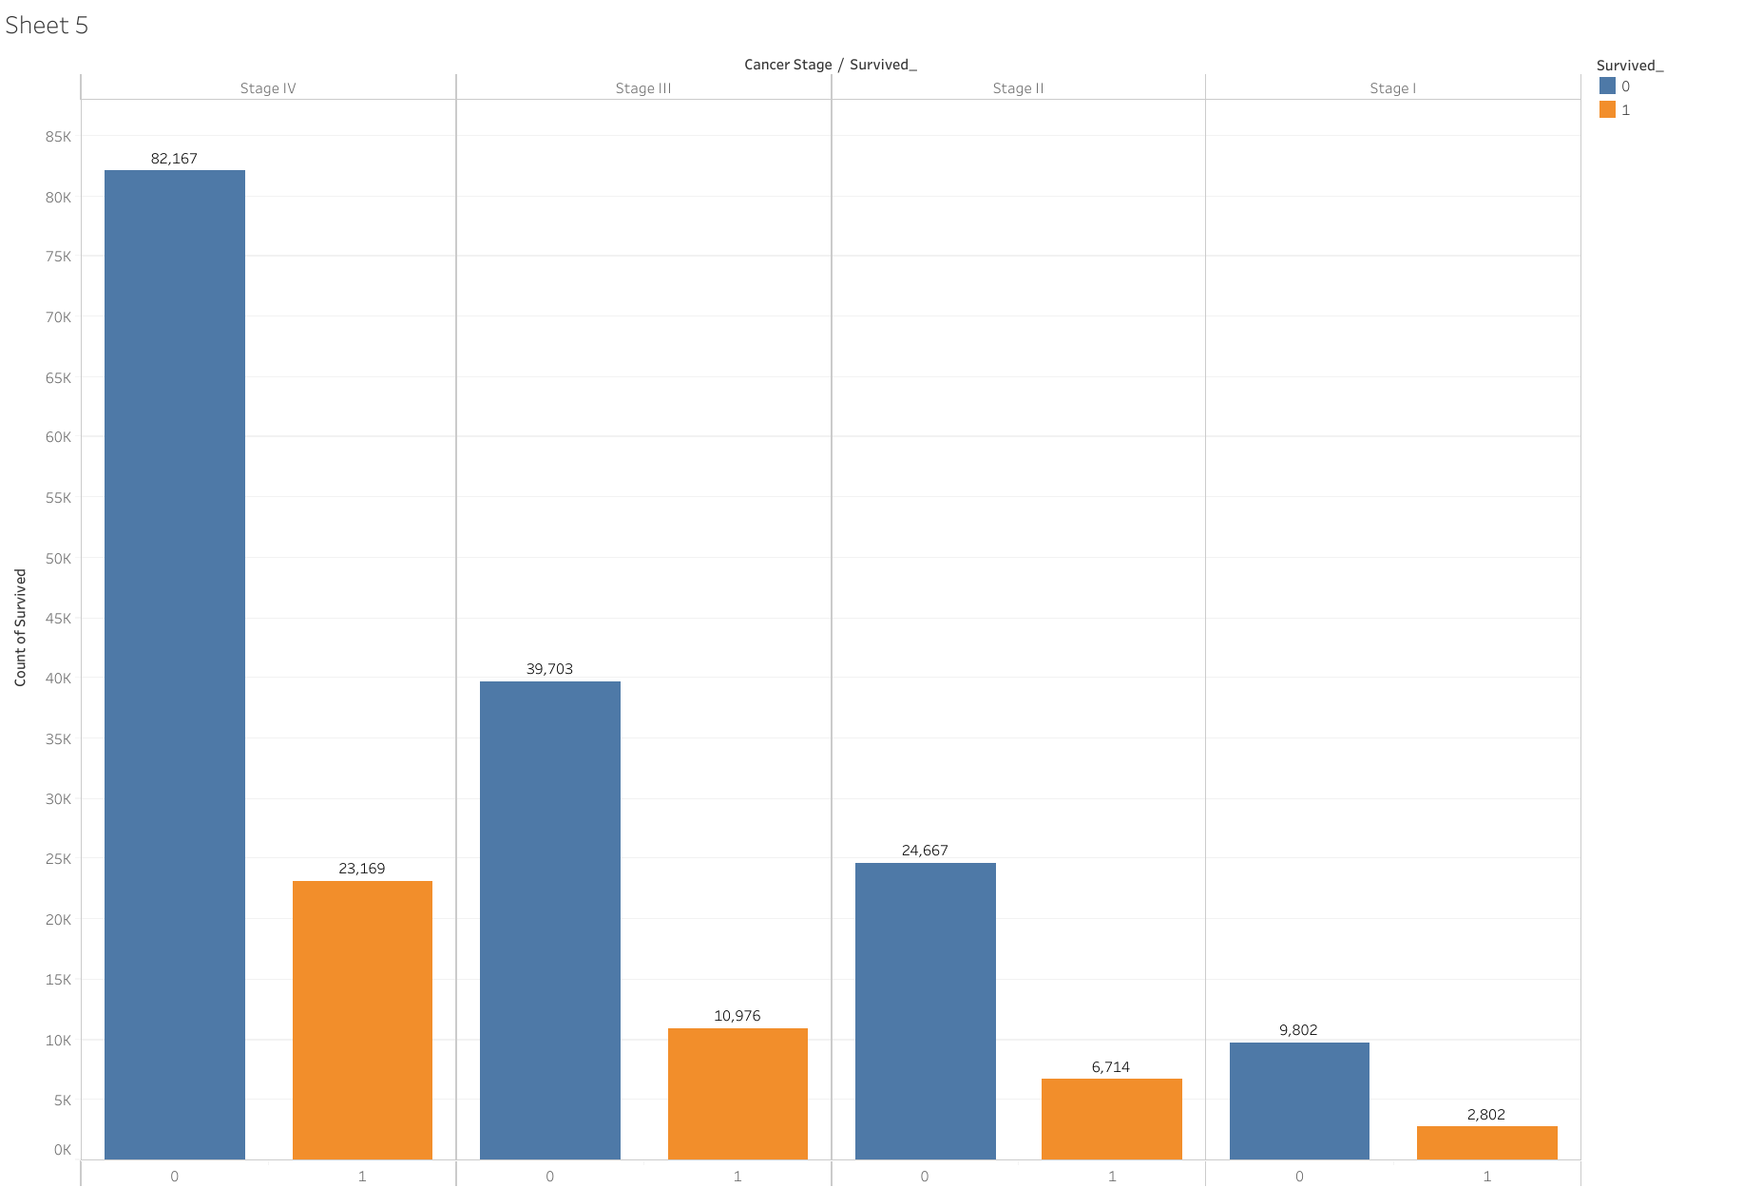
EDA-Survival By Cancer Stage

Slide 11
Model Selection and Training
Model Trained | Accuracy
Logistic Regression | 47%
K-Nearest Neighbors | 53%
Extra Tree Classifier | 70%
Random Forest | 28%

Slide 12
Model Selected and Deployed – Extra Tree Classifier – Model accuracy was 70%
Extra Trees Classifier ensemble learning method that builds multiple decision trees and merges them together to improve accuracy and control overfitting.
Bagging ensemble method, similar to Random Forests.
Extra Trees introduce more randomness by selecting a random subset of features and thresholds for splitting nodes.
Creates multiple subsets of the training data using bootstrapping.
Predictions are made by aggregating the predictions from all trees(models).
Use Cases: Commonly used in fields such as finance (credit scoring), healthcare (disease prediction), and marketing (customer segmentation).

Slide 13
Conclusion
In our analysis of lung cancer survival prediction using a comprehensive dataset of 200,000 patients, we employed various machine learning models, including Logistic Regression, Extra Trees Classifier, Random Forest, Knn. Extra Trees Classifier & Knn outperformed Logistic Regression and Random Forest. The findings from our predictive models can inform clinical decision-making and personalized treatment plans. By identifying high-risk patients, healthcare providers can prioritize interventions and allocate resources more effectively, ultimately improving patient outcomes. Thus integration of machine learning in lung cancer survival prediction represents a promising advancement in oncology

